Slide 1

PGH Hotel Booking
SUBMITTED BY:
Pratik Gaurang
Gaurav Mandli
Honey Patel

Slide 2
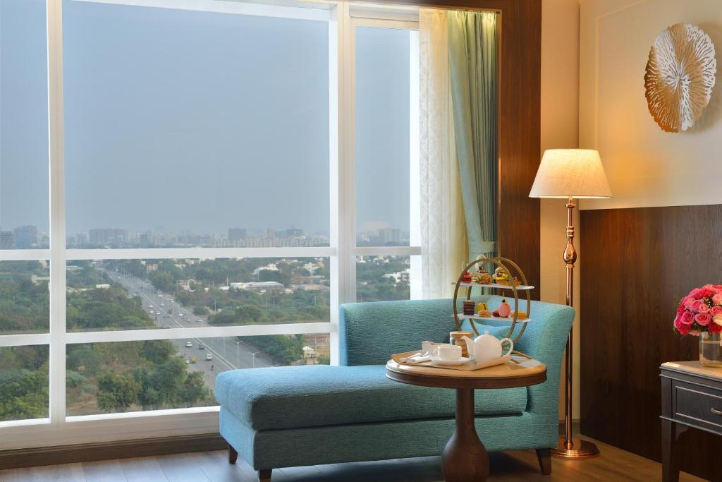
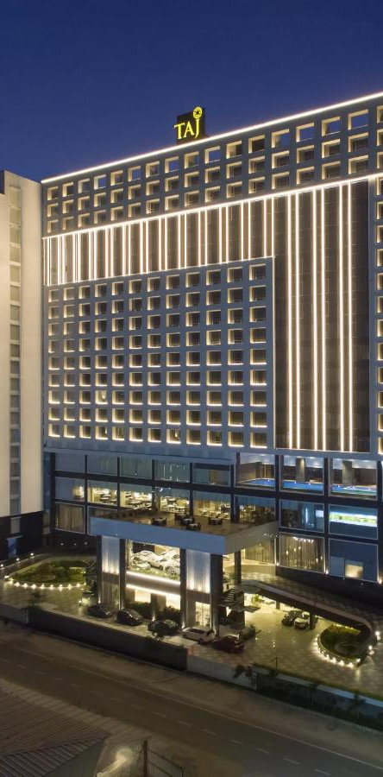
CONTENT
Introduction
Project Management
System Requirement Study
Proposed System
System Degisn
Testing
Limitations & Future Extensions
Conclusion & References

Slide 3
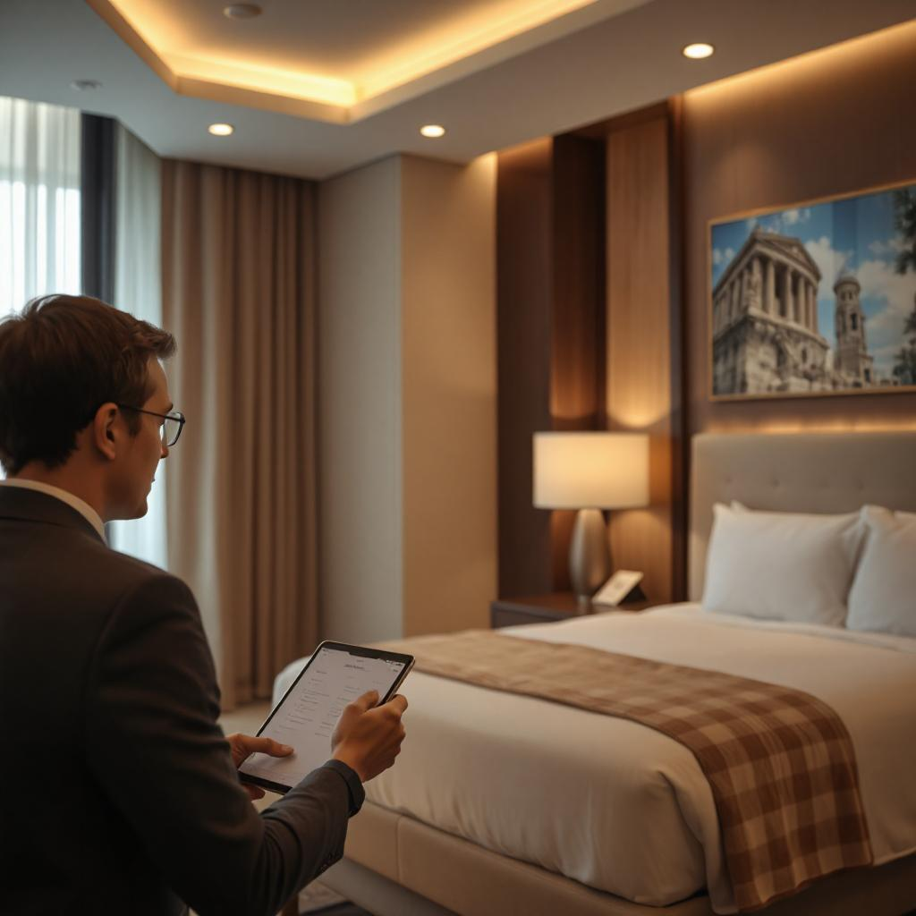
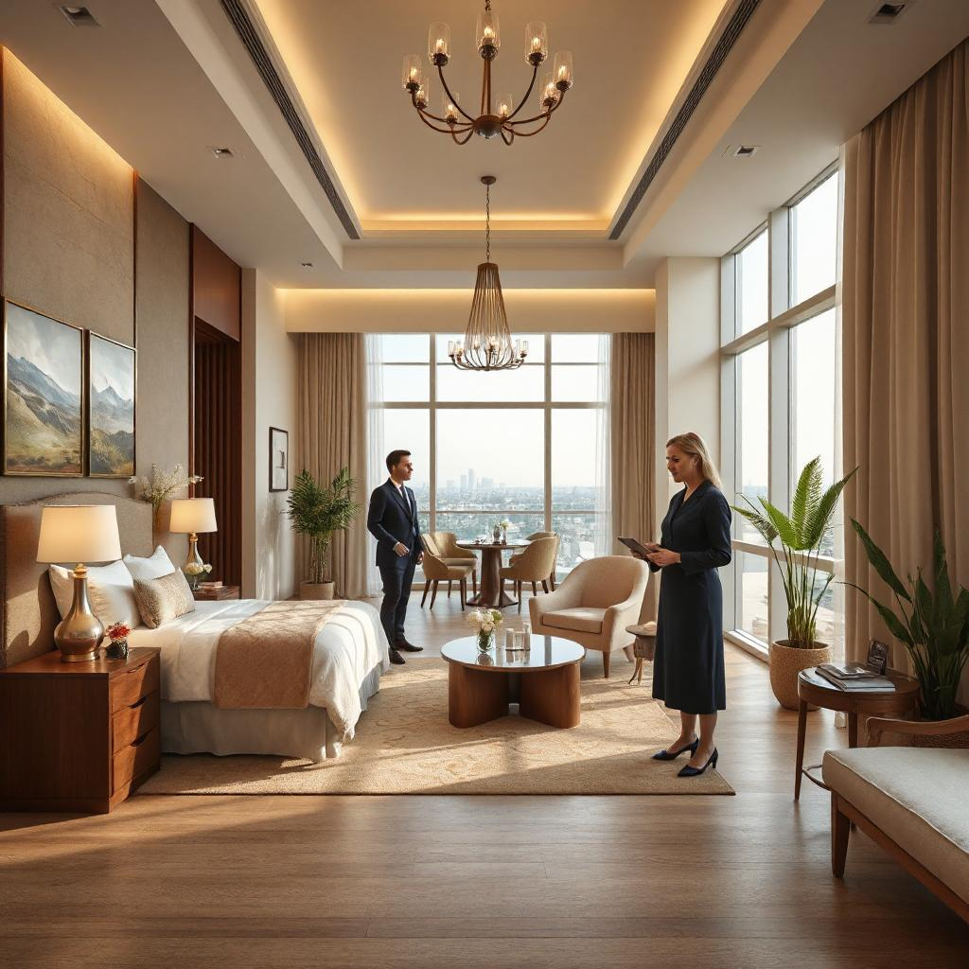
INTRODUCTION
PROJECT DETAILS
➔ Our Website PGH hotel booking is based on GOIBIBO online hotel booking
and TRIVAGO.
➔ After seeing the website of TRIVAGO and GOIBIBO, We also thought of
creating a similar website. We liked a lot about them.
➔ GOIBIBO has a user-friendly interface that enables users to easily search and
book hotels.
➔ within TRIVAGO and GOIBIBO website you can book any hotel in the whole
World.
➔ But in our website we can only book hotels in some touristic cities of Gujarat
State of India.

Slide 4
1.2 PURPOSE ➔ Just like TRIVAGO and GOIBIBO, our website is Provides room bookings, Checking, Checkout, Hotel and Room’s photos, hotel review and ratings, all facilities can be viewed. ➔ The user can use any if there is a query, user can also contact on mail. ➔ Anyone who wants to enter our website as a visitors can view the available hotel, Rooms and facilities but can’t book hotel rooms. 1.3 SCOPE our website is Provides room booking, Checkin, Checkout, hotel and room’s photos, hotel review and ratings, all facilities can be viewed. the user can also the user can use any if there is a query, user can also contact on mail. 1.4 OBJECTIVES The main objective of PGH hotel booking website is to manage details of hotels, rooms, user , show availability. It manage all the information about Hotels, booking. The website is totally built in administrative end and thus the only admin is guaranteed the access.

Slide 5
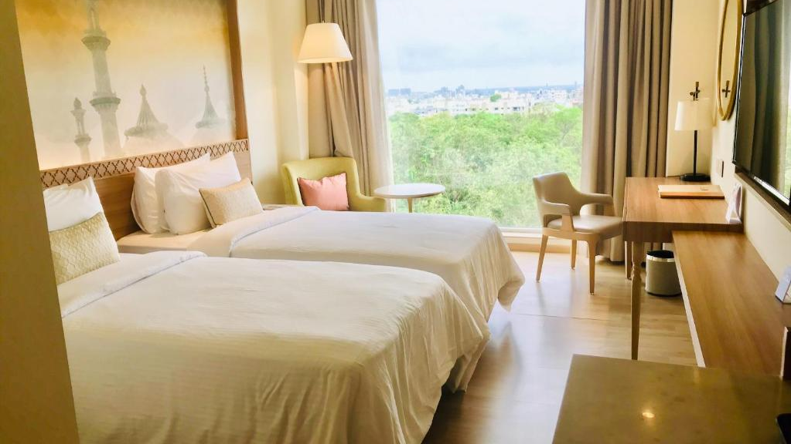
Unforgettable moments, unforgettable stay.

Slide 6
FEASIBILITY STUDY: Technical Feasible: Technical feasibility determines whether the work for the project can be done with the existing equipment, software technology and available personal. Technical feasibility is concerned with specifying equipment and software that will satisfy the user requirement. Operational Feasibility: Operation feasibility is a measure of how people feel about the system. Operational Feasibility criteria measure the urgency of the problem or the acceptability of a solution. Operational Feasibility is dependent upon determining human resources for the project. It refers to projecting whether the system will operate and be used once it is installed.
PROJECT MANAGEMENT
Notes:
ID=dd91c577-f997-49fe-a5eb-611d59b20eb8 Recipe=crop Type=Foreground Variant=0 FamilyID=ClassicFrameGoudy_Zero

Slide 7
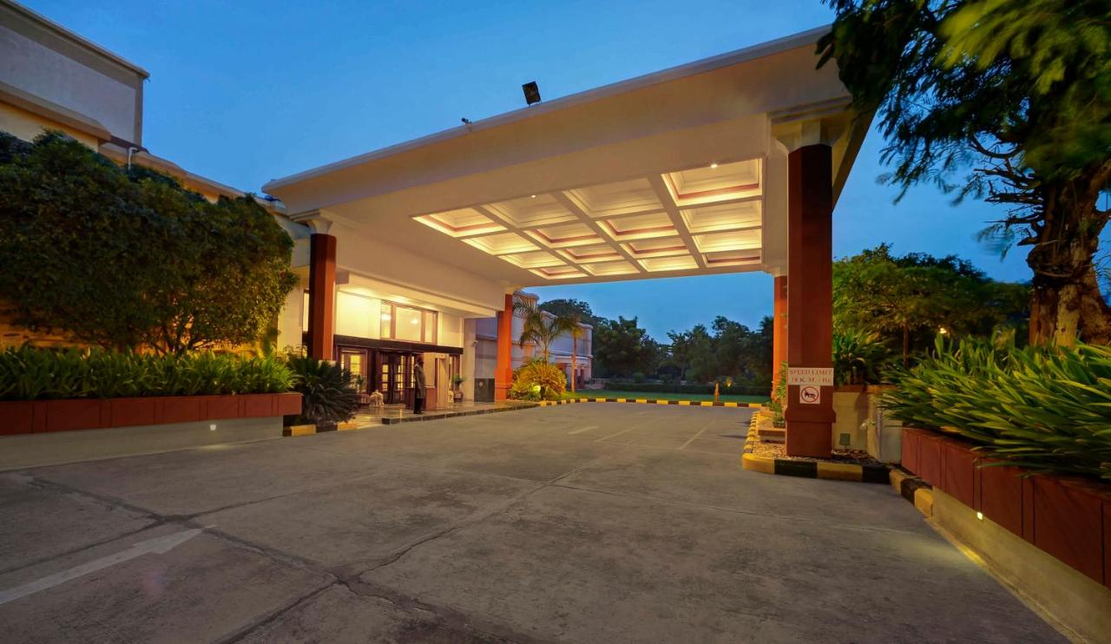
Economical Feasibility: Economical feasibility has great importance as it can outweigh other feasibilities because costs affect organization decisions. The concept of Economic Feasibility deals with the fact that a system that can be developed and will be used on installation must be profitable for the Organization.

Slide 8
SYSTEM REQUIREMENT STUDY
3.1 STUDY OF CURRENT SYSTEM
This system provides a common platform through which a user can book a hotel. Here user can register and then book any hotel. Each time changes in database should be updated. So there would be very low performance.
Now a day’s users have to manually go through all the individual sites of each and every provider to check the availability of the room and hotel.
Project work is devided mainly in three modules like user, admin, and visitor.
3.2 PROBLEMS AND WEAKNESS OF CURRENT SYSTEM
➔ Require more accuracy
➔ Require more resources
➔ Not interaction
➔ Provide less functionality
➔ Our sites are complicated for admin due to generate error.

Slide 9
3.3 HARDWARE AND SOFTWARE REQUIREMENTS:
Hardware Requirements (Minimum):
Software Requirements:
Operating System: Windows 7, Windows 8.1, etc…
Front End Tools: PHP
Back End Tools: MySQL
Office Automation Tools:
Microsoft Office Word
Microsoft Visio
Component | Specification
Processor | Intel Core 2 Duo
RAM | 4 GB RAM
Hard Disk | 500 GB

Slide 10
REQUIREMENT OF PROPOSED SYSTEM
4.1 MAIN MODULES OF THE SYSTEM:
There are basically three main modules in the systems.
Admin User
Registered User
Visitor User
4.2 MODULE DESCRIPTION:
There are three modules in this system.
Admin User:
➔ Admin can control the entire website.
➔ That Users can view, view bookings, view ratings and reviews.

Slide 11
Registered User:
➔ A register user are use the website.
➔ Registered user can login to the website, view hotels and booking’s room and
give the reviews.
Visitor:
➔ Visitor is a person who first time visit website.
➔ Visitor can only view the homepage, search for hotel’s and register for a new
Account
4.3 FEATURES OF NEW SYSTEM:
➔ user friendly interface.
easy booking process. ➔ image gallery.
google map integration. ➔ discounts.

Slide 12
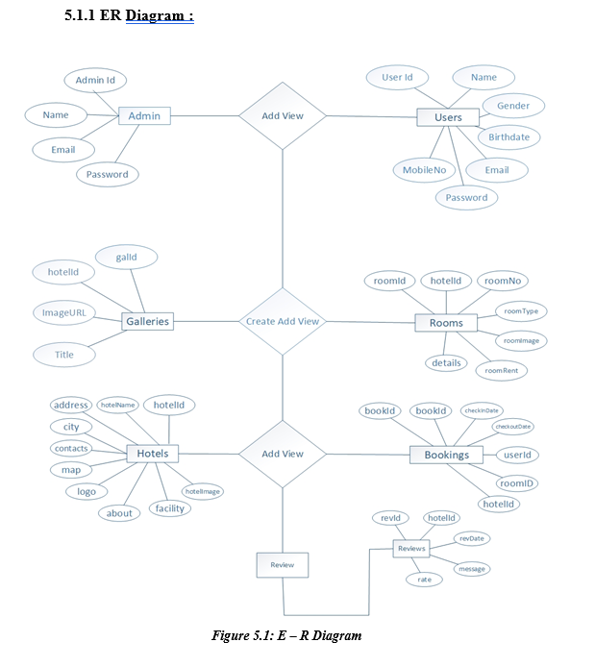
SYSTEM DESIGN
5.1 SYSTEM ARCHITECTURE DESIGN:

Slide 13
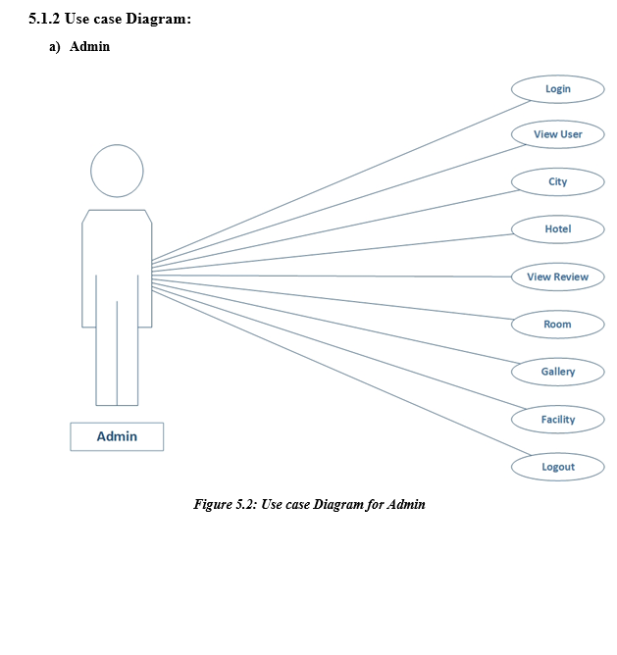
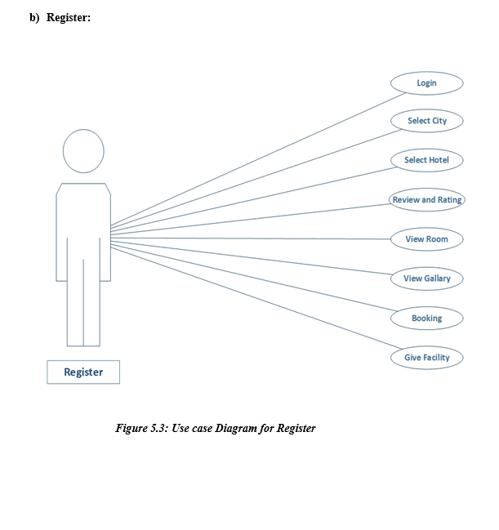

Slide 14
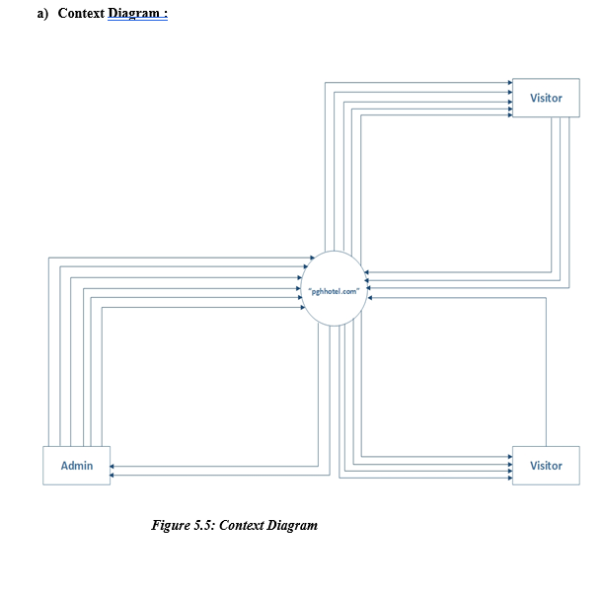

Slide 15
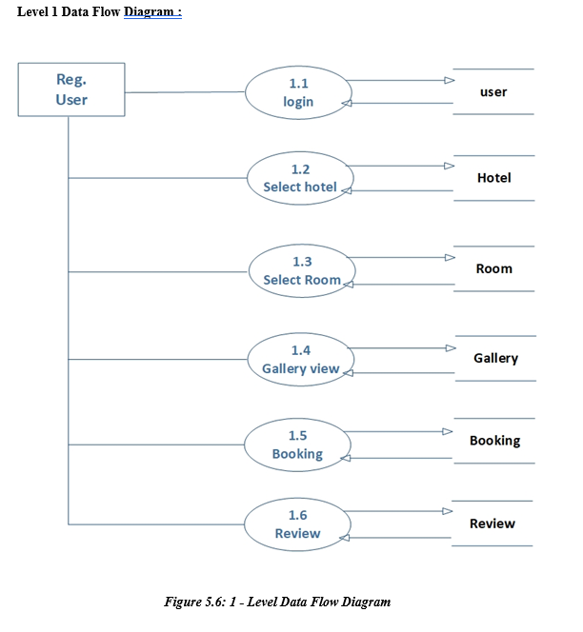
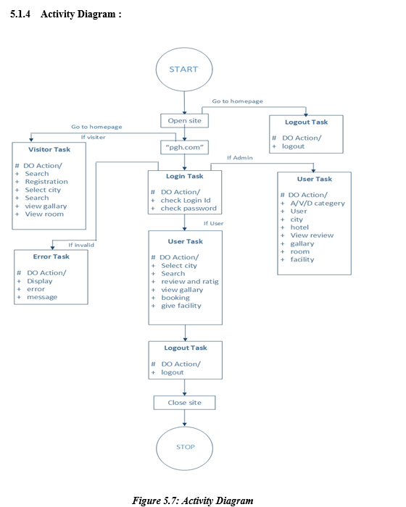

Slide 16
5.2 DATA DICTIONARY
Table Name: admins
Description: Store The admins Details
Table Name: galleries Description: Store The galleries Details
SR. No | FIELD NAME | DATA TYPE | SIZE | CONSTRAINT | DESCRIPTION
1 | adminId | Int | 5 | Primary key | Id of admin
2 | name | Text | 50 | Not null | Name of admin
3 | emailId | Text | 50 | Unique key | Email of admin
4 | password | Text | 30 | Not null | Password of admin
SR. No | FIELD NAME | DATA TYPE | SIZE | CONSTRAINT | DESCRIPTION
1 | gallId | Int | 5 | Primary key | Id of galleries
2 | hotelId | Int | 5 | Reference key | Id of hotelId
3 | imageURL | Text | 50 | Not null | image of galleries
4 | title | Text | 50 | Not null | Title of galleries

Slide 17
Table Name: users
Description: Store The users Details
SR. No | FIELD NAME | DATA TYPE | SIZE | CONSTRAINT | DESCRIPTION
1 | userId | Int | 5 | Primary key | Id of users
2 | name | Text | 50 | Not null | Name of users
3 | gender | Text | 10 | Not null | Gender of users
4 | birthdate | Date | - | Not null | BirthDate of users
5 | emailId | Text | 50 | Unique key | Email of users
6 | password | Text | 30 | Not null | Password of users
7 | mobileNo | Text | 10 | Unique key | MobileNo of users

Slide 18
Table Name: hotels
Description: Store The hotels Details
SR. No | FIELD NAME | DATA TYPE | SIZE | CONSTRAINT | DESCRIPTION
1 | hotelId | Int | 5 | Primary key | Id of hotel
2 | hotelName | Text | 50 | Not null | Name of hotel
3 | Address | M. text | - | Not null | address of hotels
4 | city | Text | 50 | Not null | City of hotels
5 | contactNo | Text | 10 | Not null | Contact of hotel
6 | map | Text | 100 | Not null | map of hotel
7 | logo | Text | 50 | Not null | hotel’s logo
8 | about | M.text | - | Not null | About of hotel
9 | facility | M.text | - | Not null | Facility of hotel
10 | hotelImage | Text | 100 | Not null | Image of hotel

Slide 19
Table Name: bookings
Description: Store The bookings Details
SR. No | FIELD NAME | DATA TYPE | SIZE | CONSTRAINT | DESCRIPTION
1 | bookId | Int | 5 | Primary key | Id of booking
2 | bookDate | Date | - | Not null | Date of bokings
3 | checkinDate | Date | - | Not null | Date of checkin
4 | checkoutDate | Date | - | Not null | Date of checkout
5 | userId | Int | 5 | Reference key | Id of users
6 | roomId | Int | 5 | Reference key | Id of rooms
7 | hotelId | Int | 5 | Reference key | Id of hotels

Slide 20
Table Name: reviews
Description: Store The reviews Details
SR. No | FIELD NAME | DATA TYPE | SIZE | CONSTRAINT | DESCRIPTION
1 | revId | Int | 5 | Primary key | Id of reviews
2 | hotelId | Int | 5 | Reference key | Id of hotels
3 | revDate | Date | - | Not null | Date of reviews
4 | message | M.Text | - | Not null | Message of reviews
5 | Rate | Int | 5 | Not null | Rate of Hotel and Rooms
6 | userId | Int | 5 | Reference key | Id of users

Slide 21
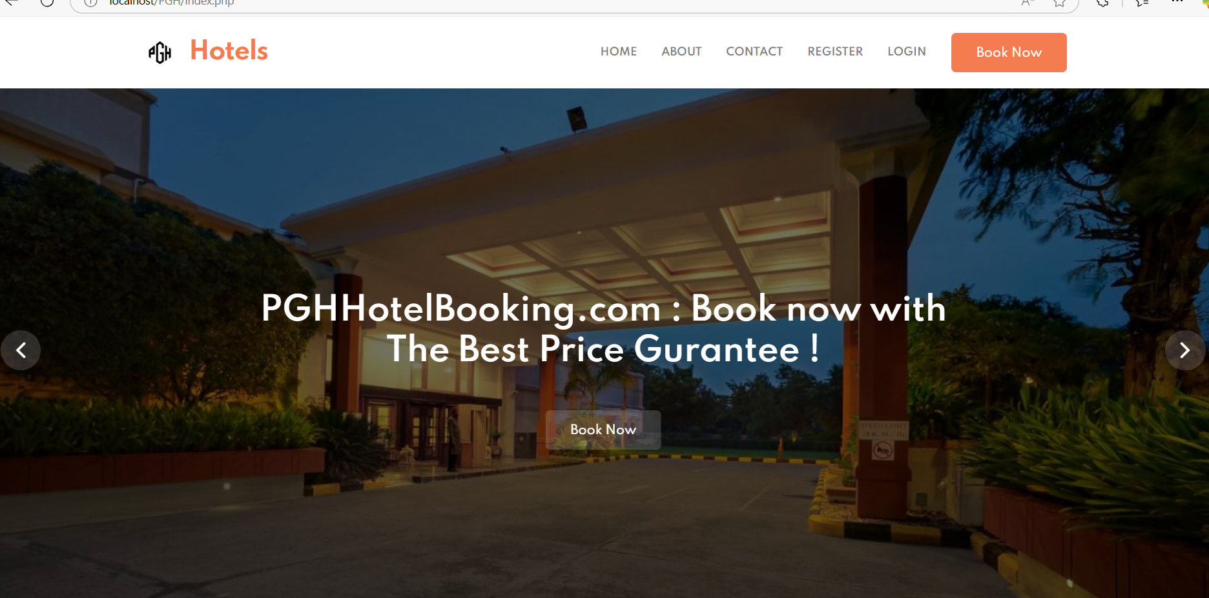

Slide 22
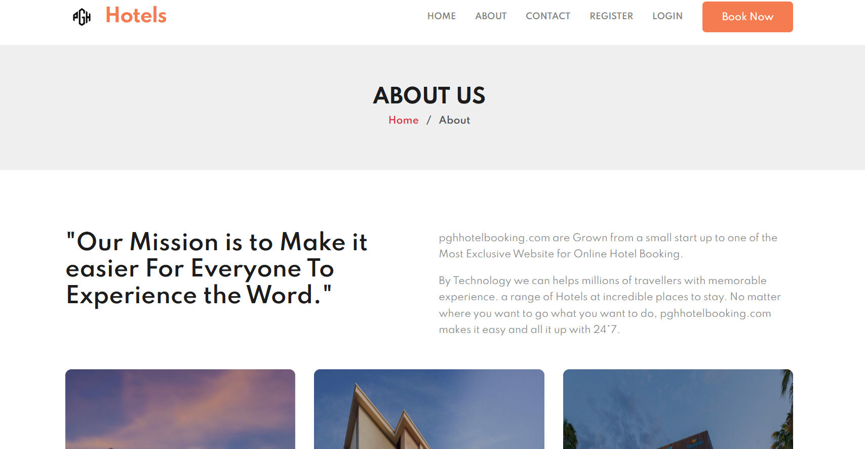
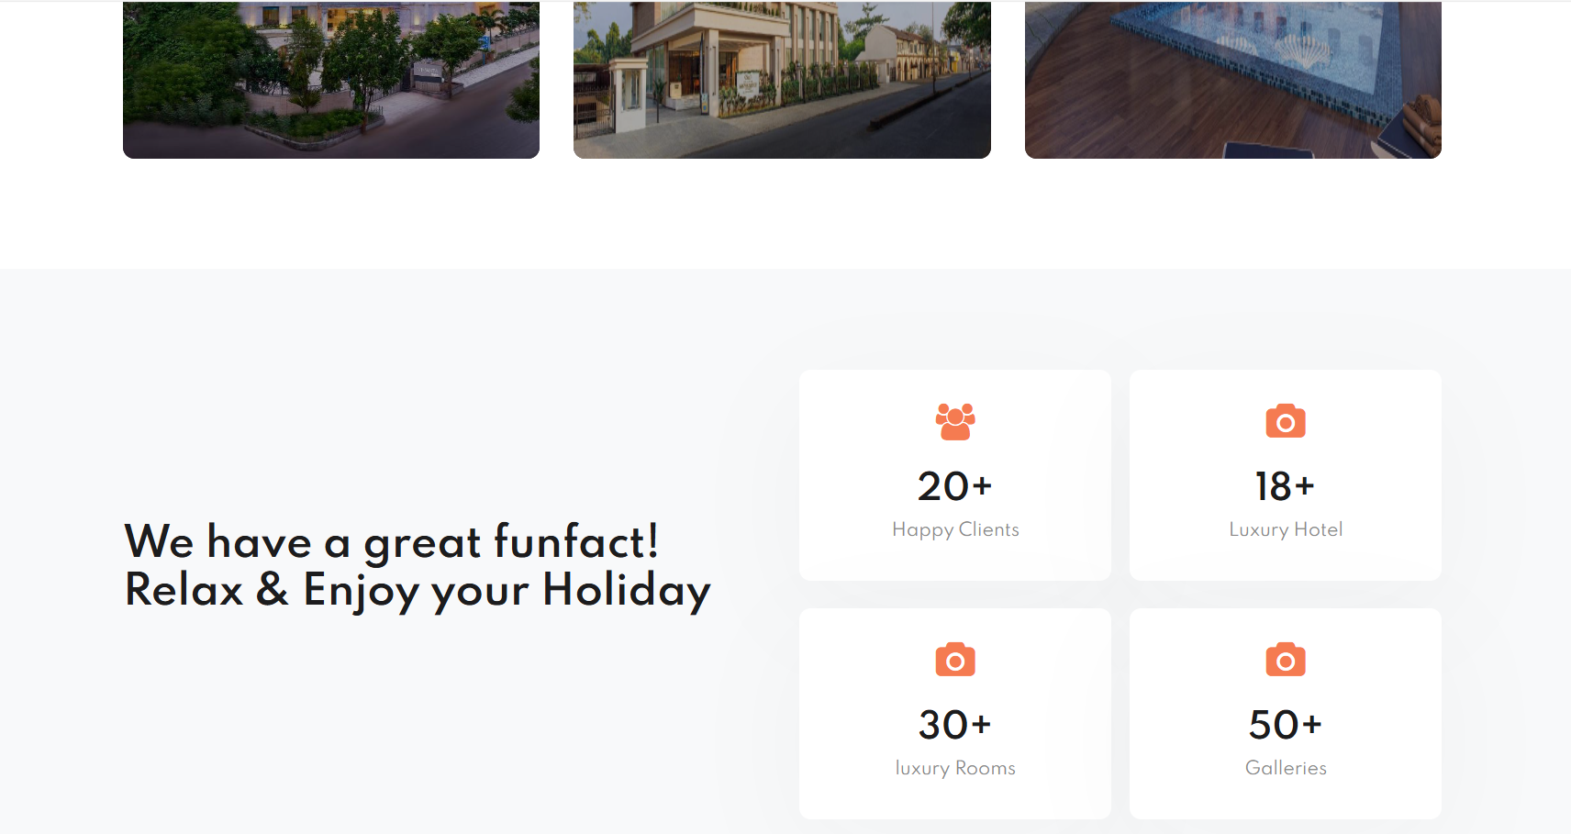

Slide 23
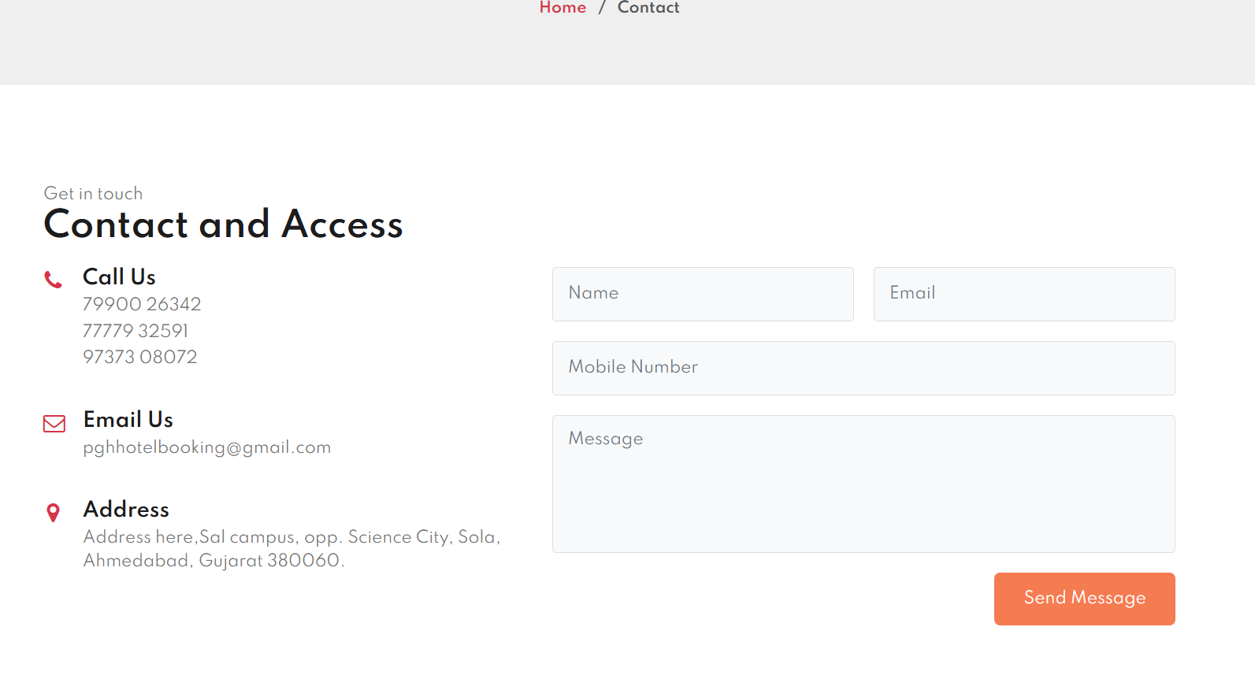

Slide 24
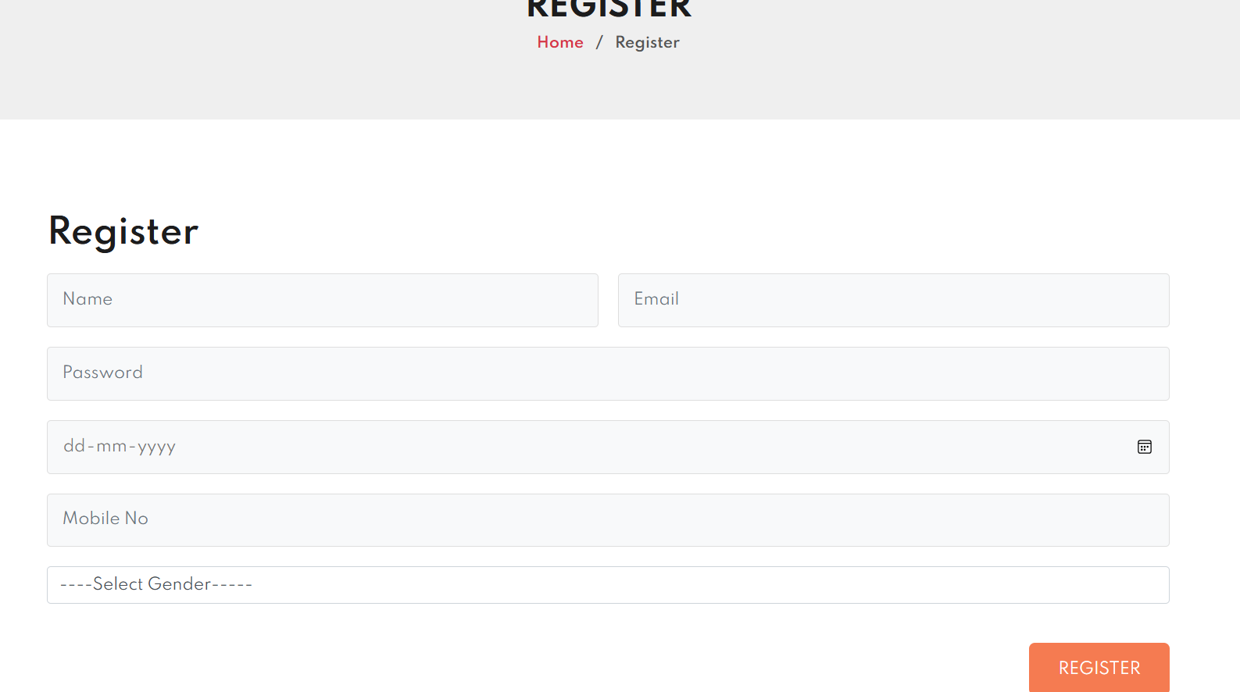

Slide 25
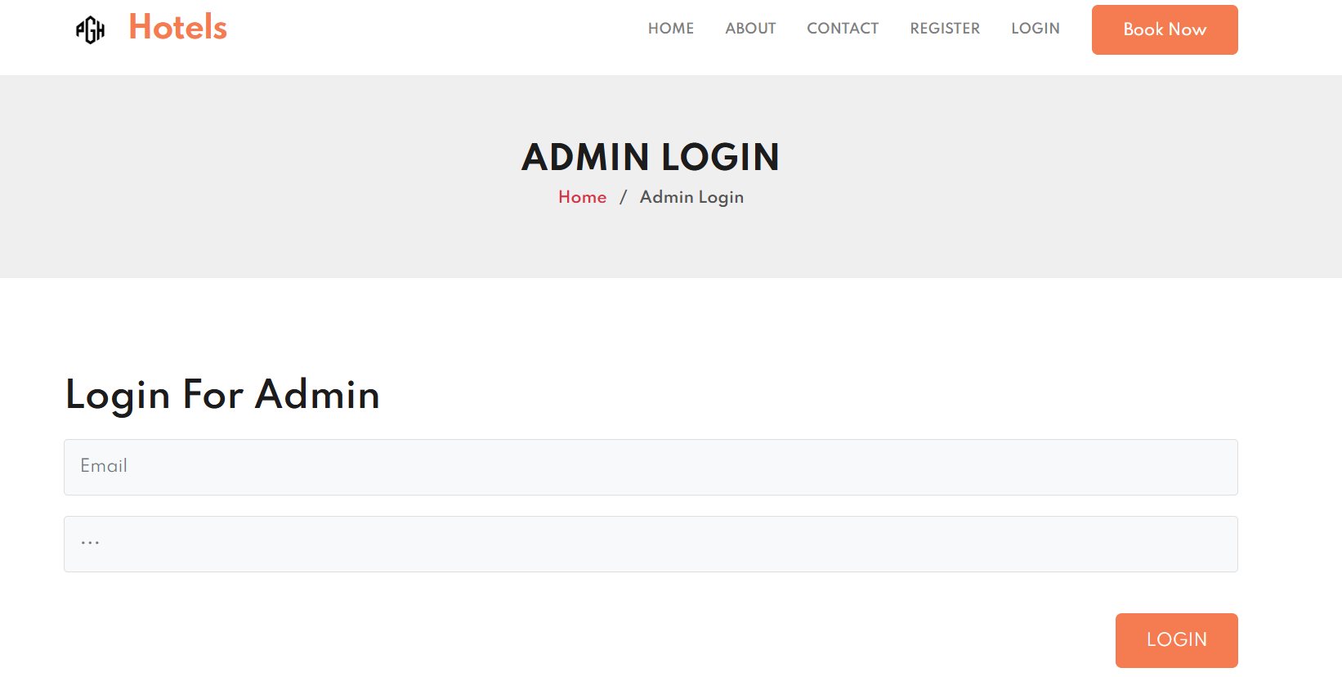

Slide 26
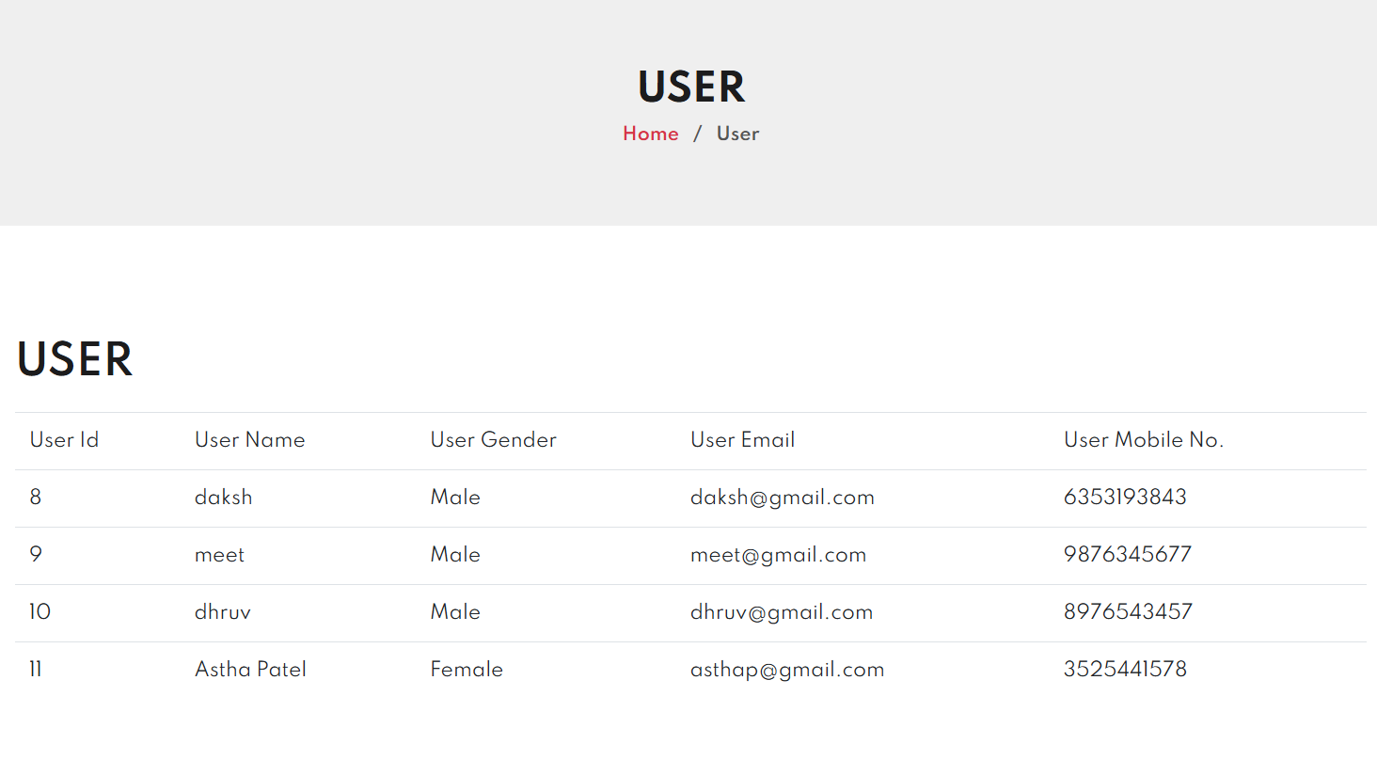

Slide 27
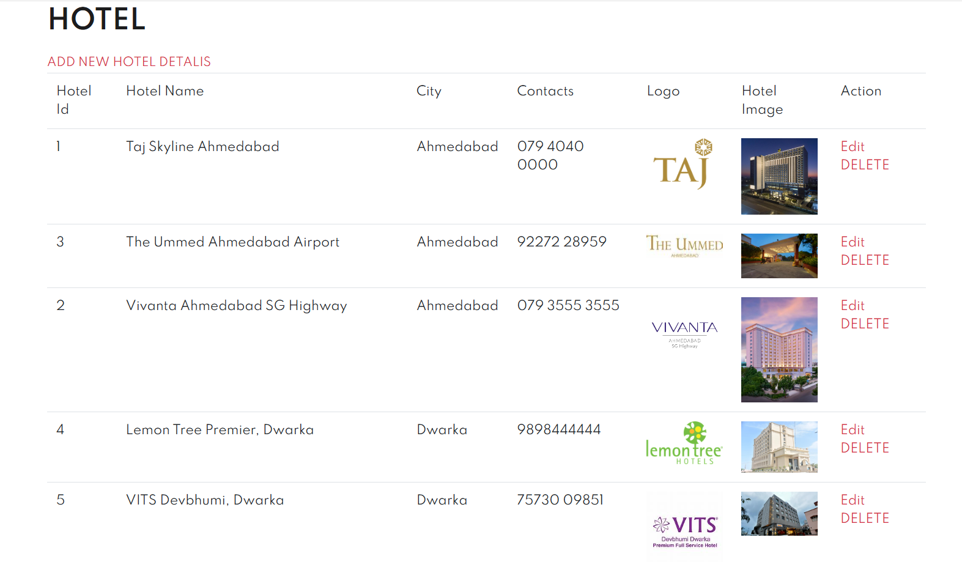

Slide 28
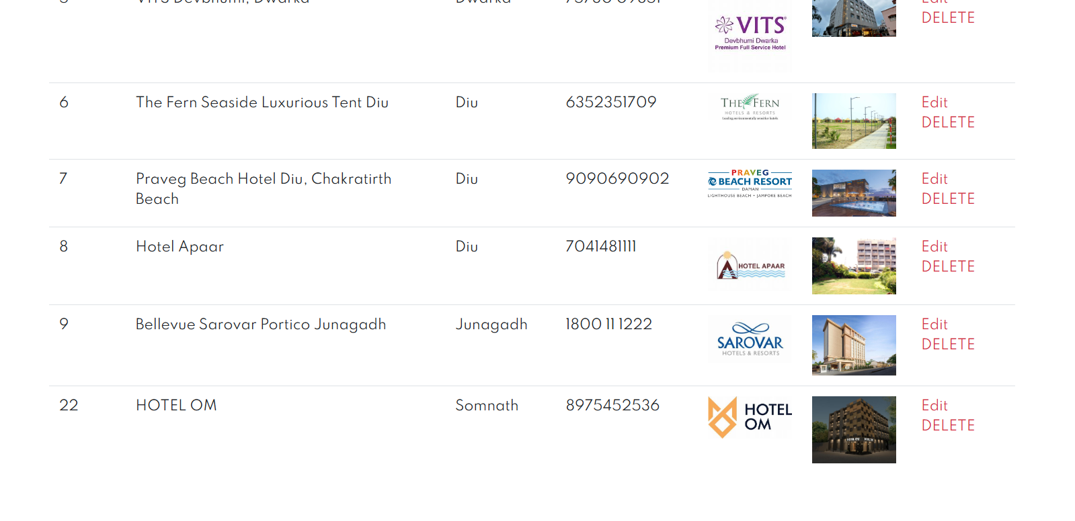

Slide 29
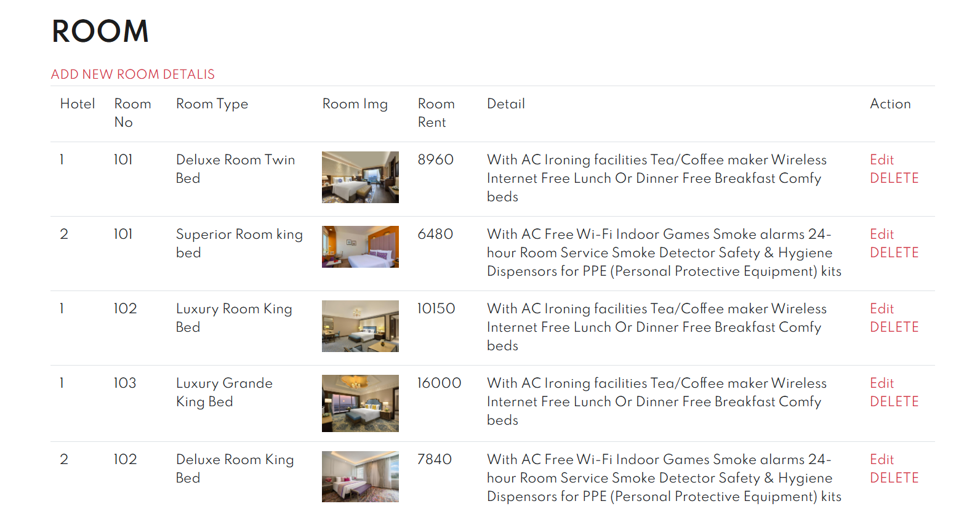
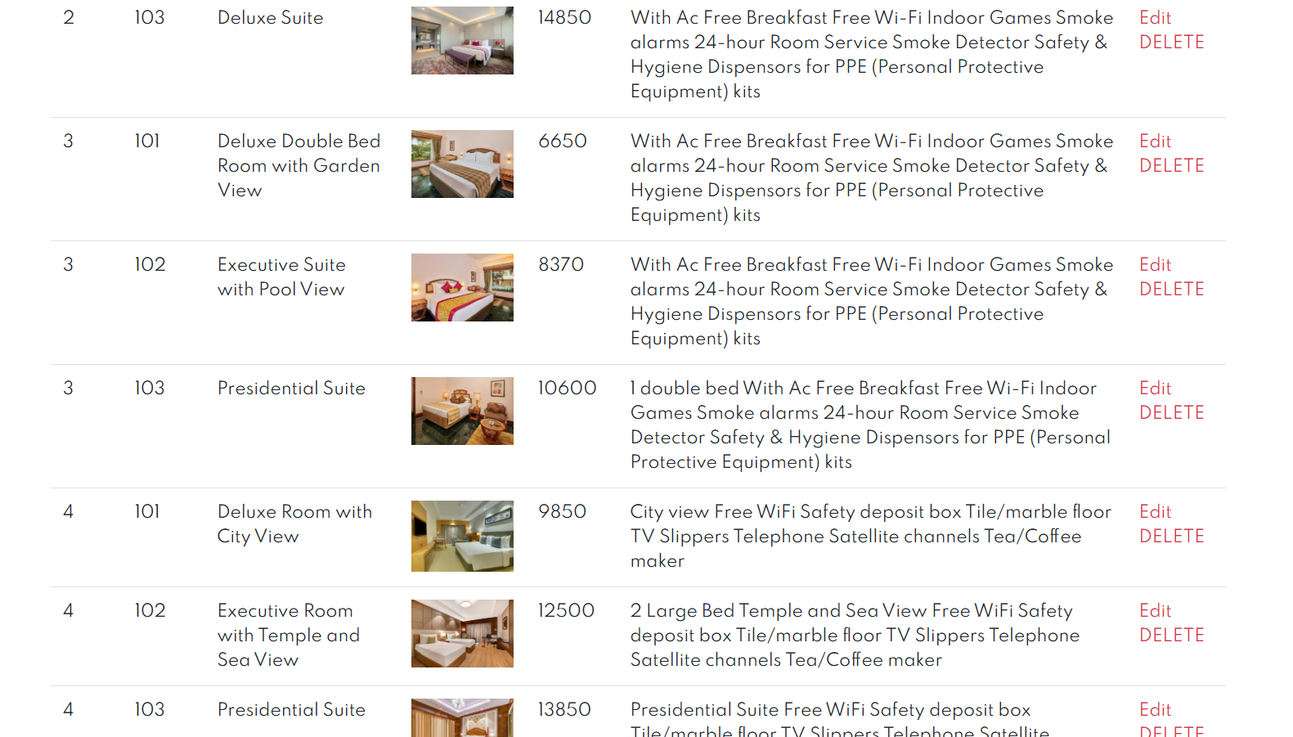

Slide 30
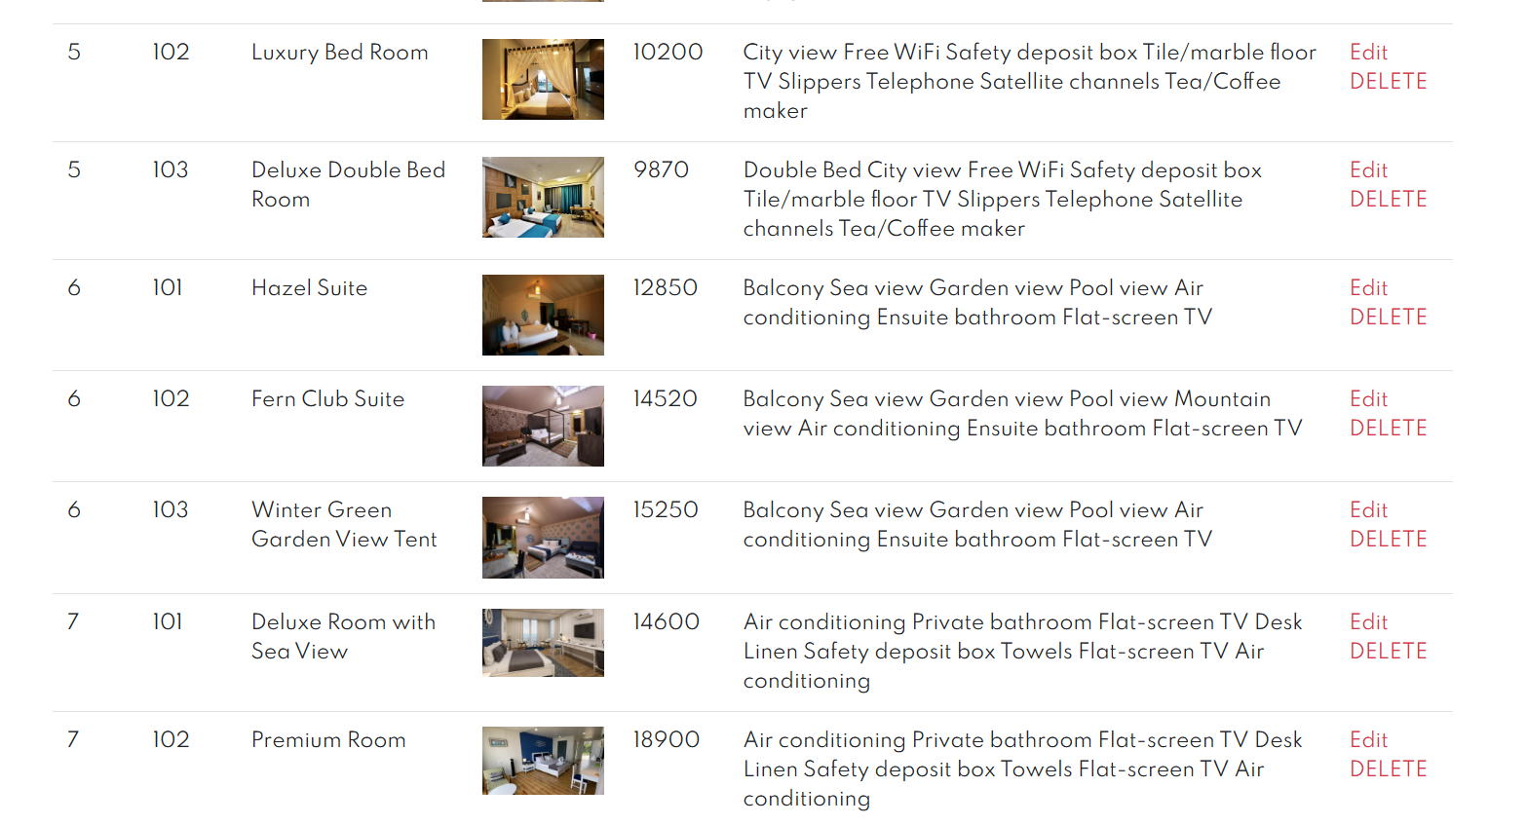
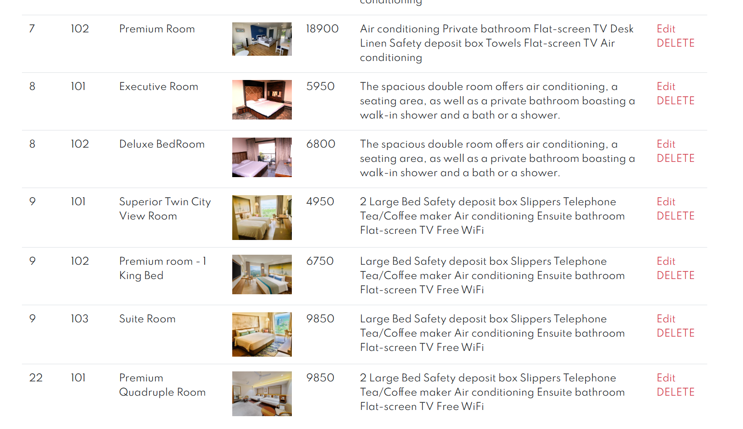

Slide 31
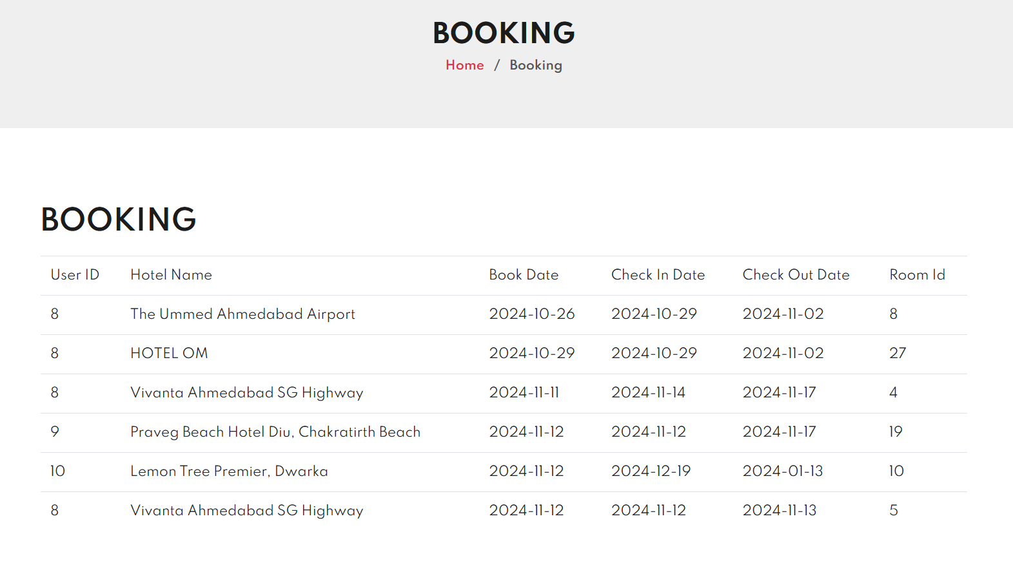

Slide 32
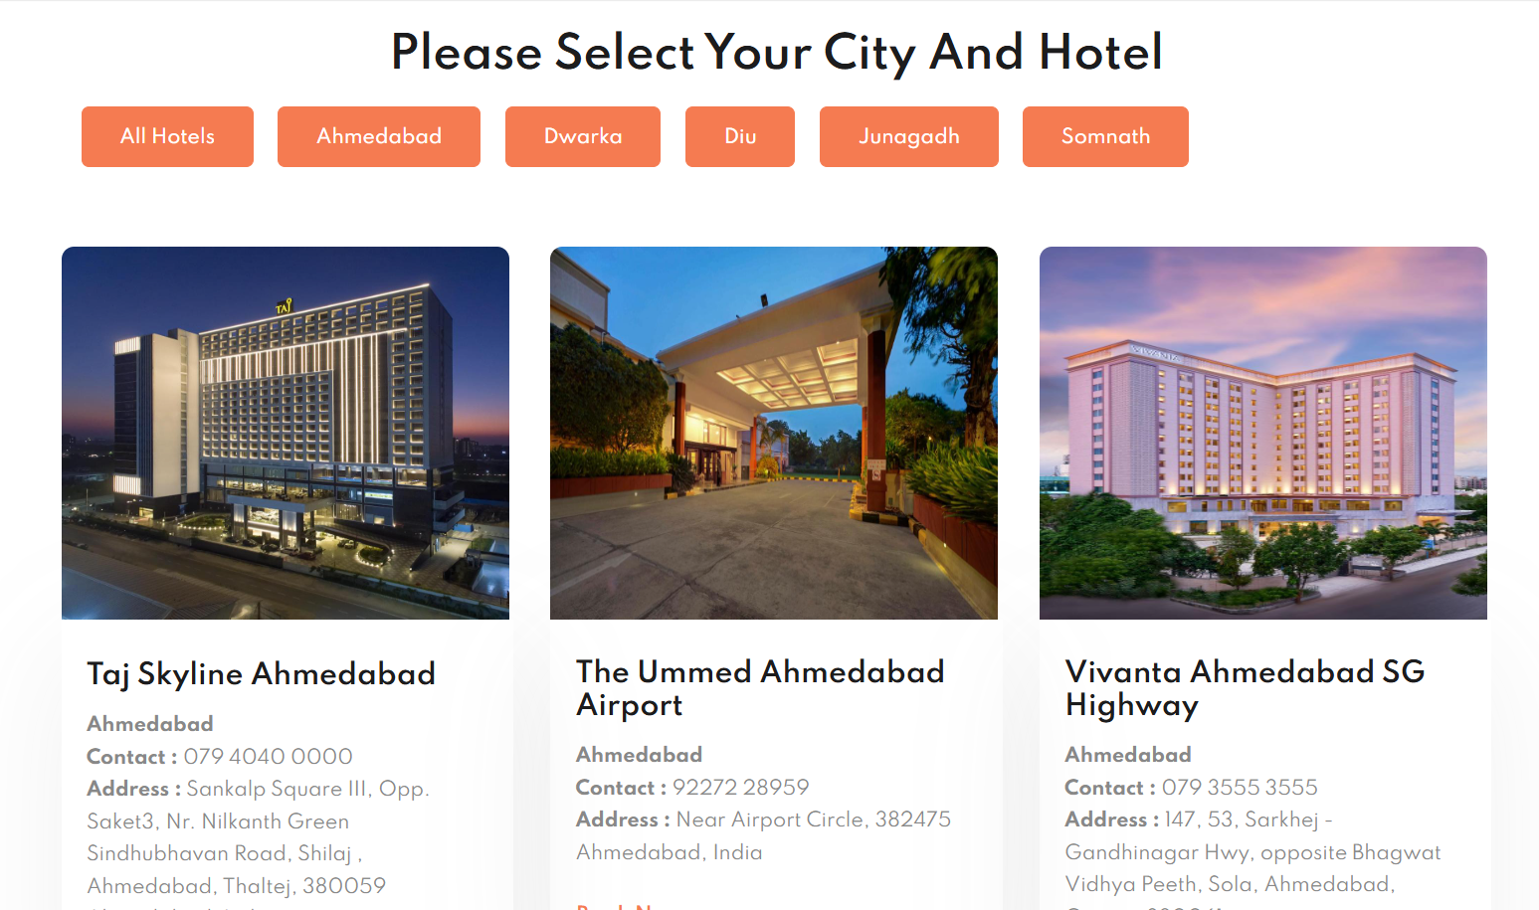

Slide 33
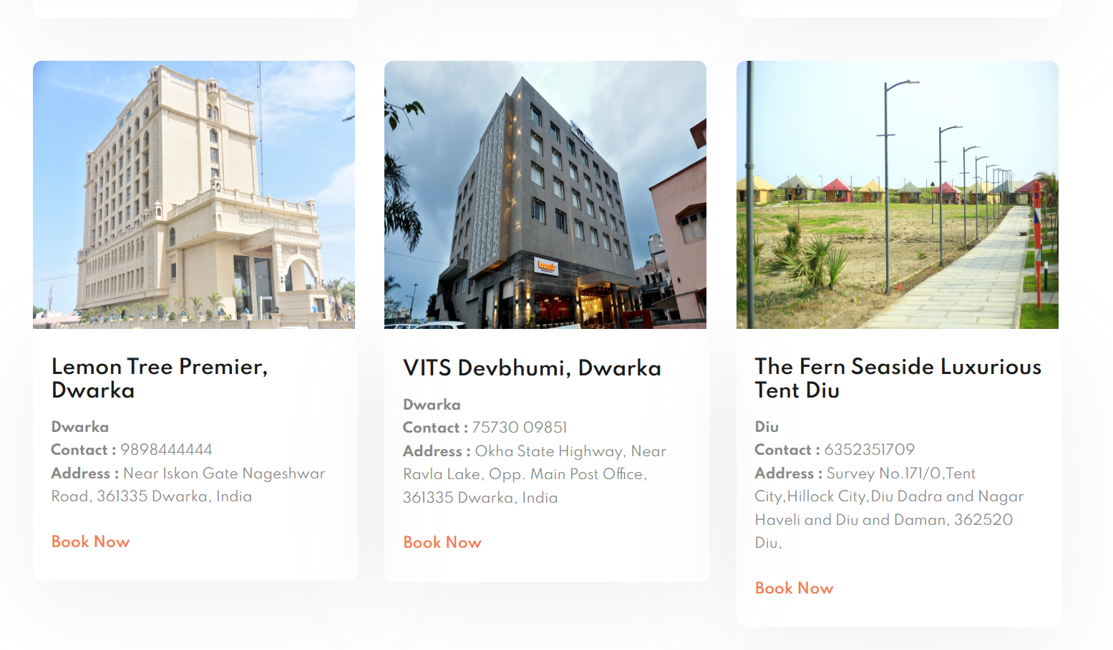

Slide 34
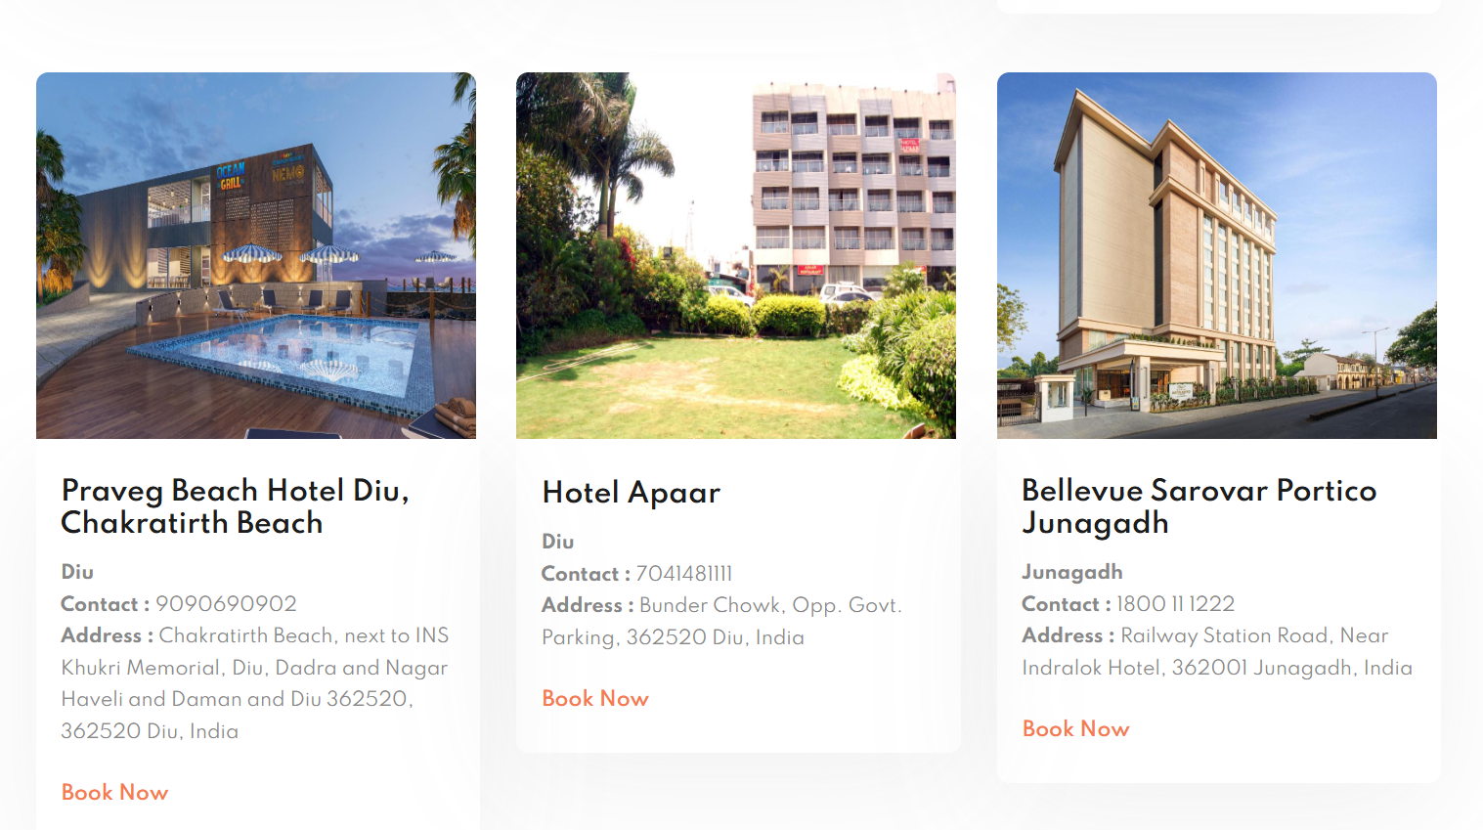

Slide 35
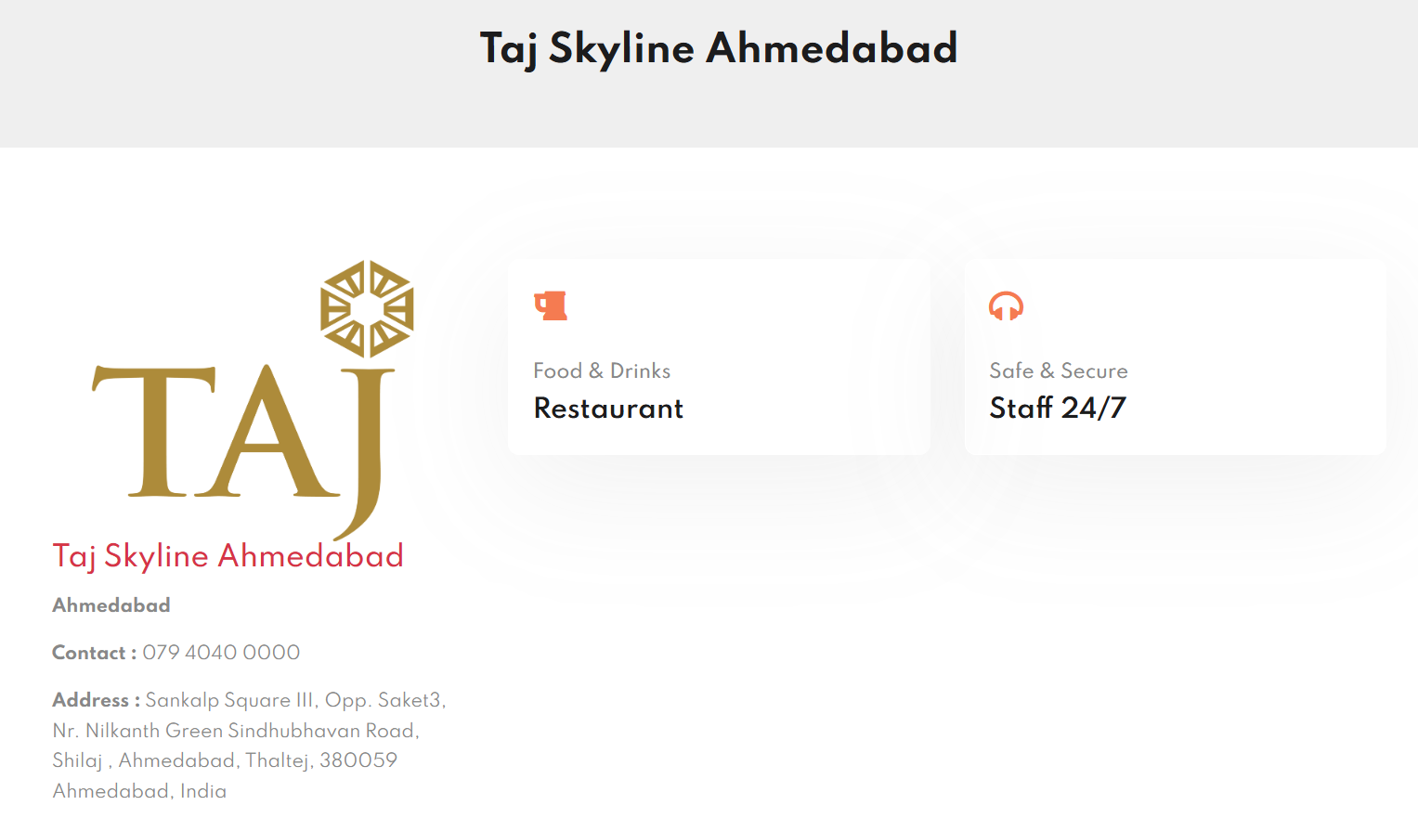

Slide 36
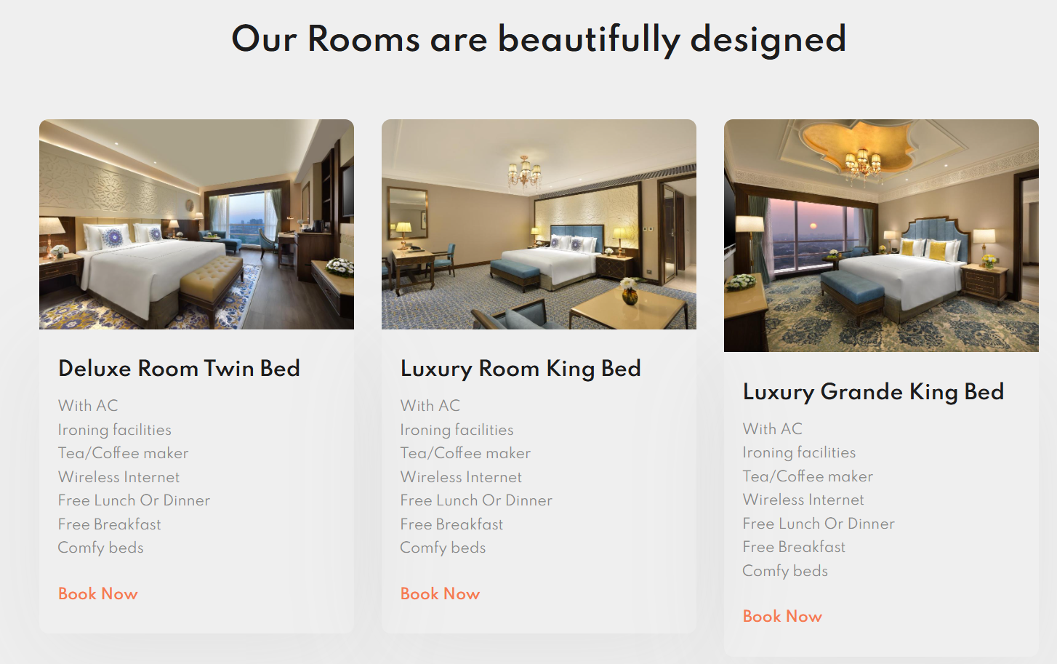
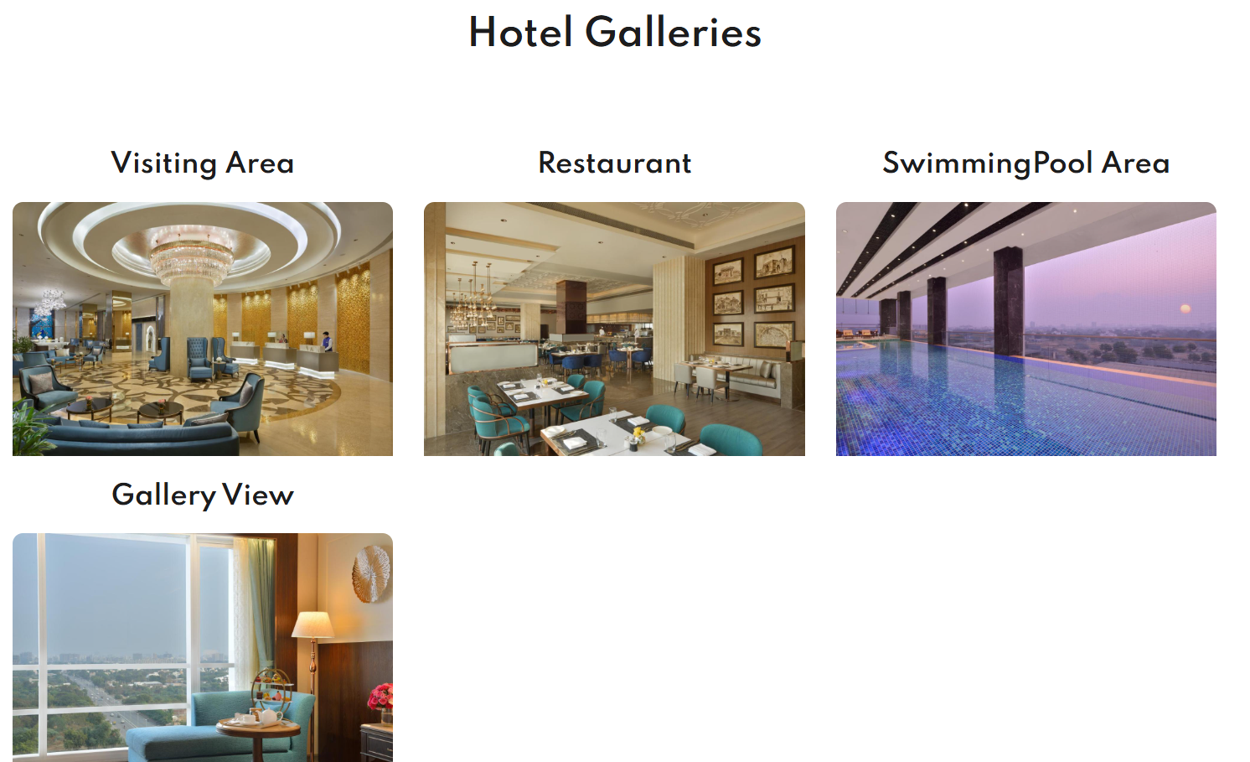

Slide 37
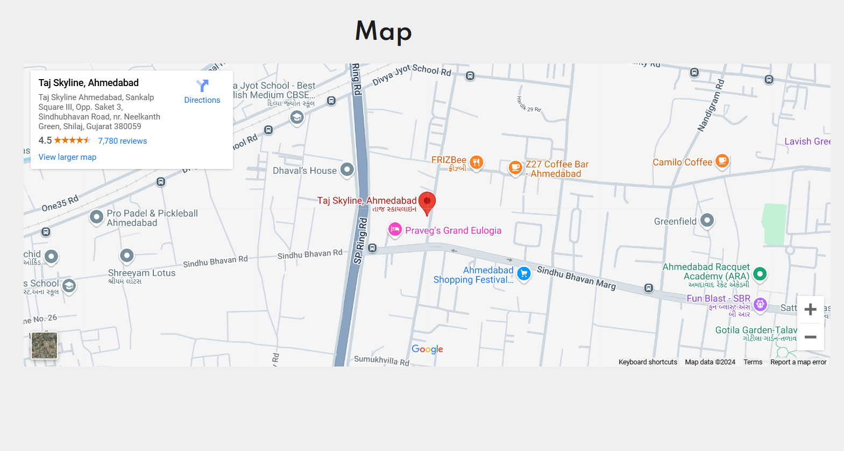

Slide 38
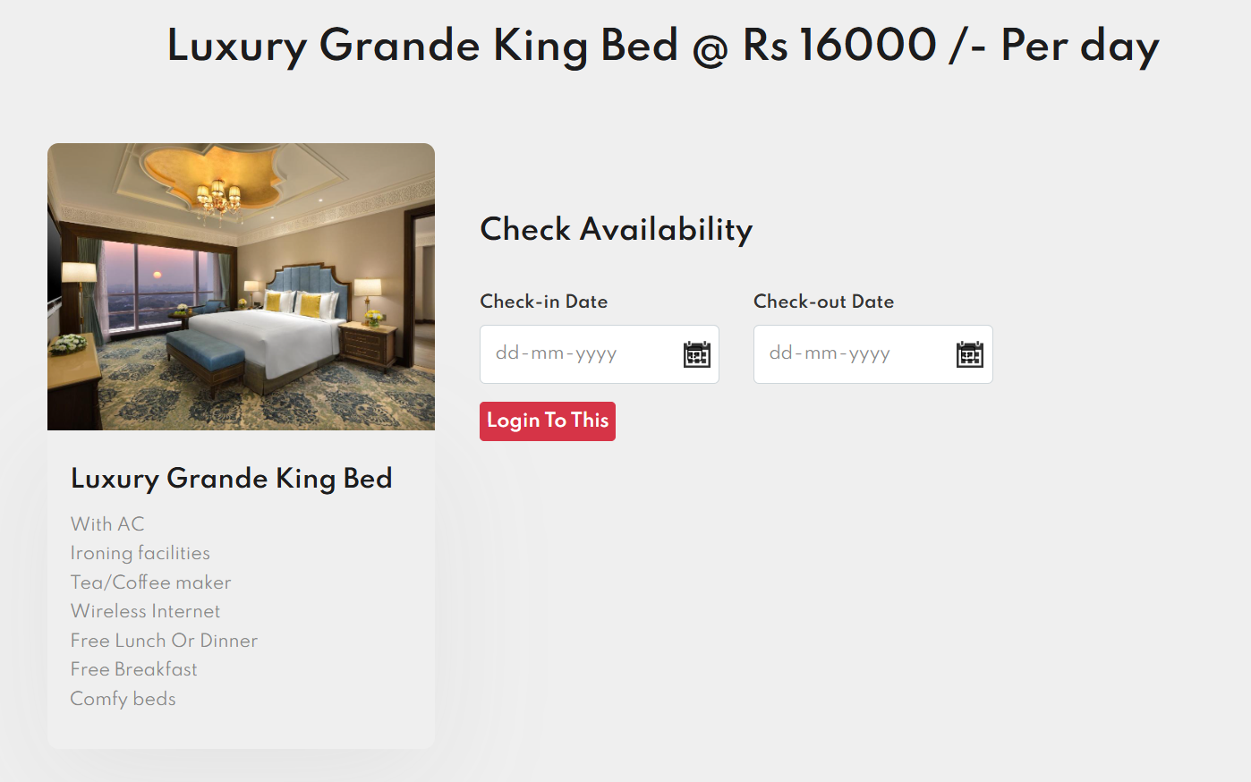
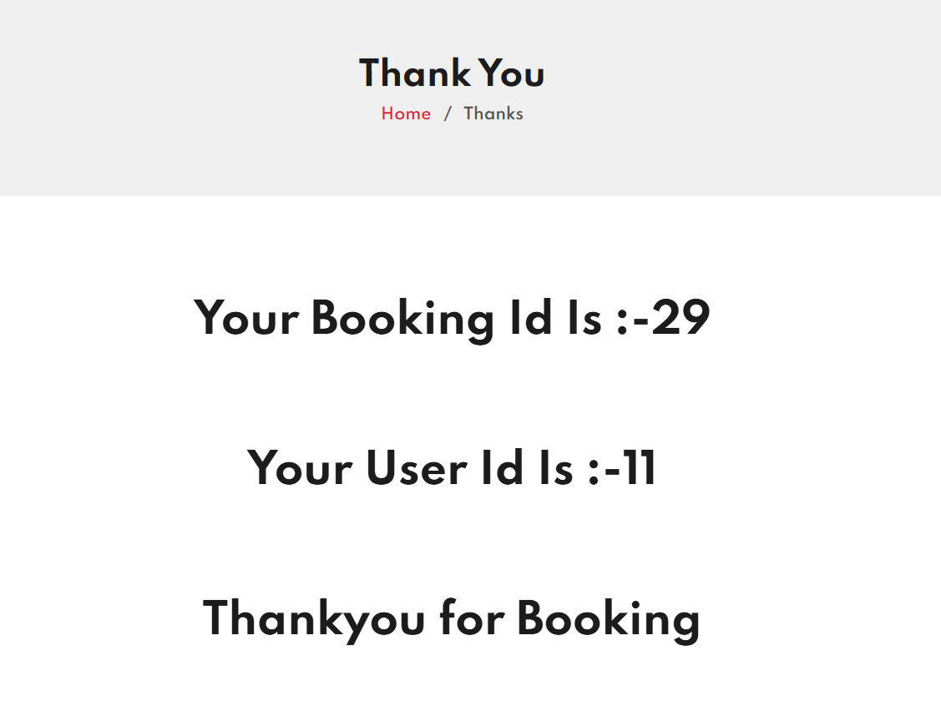

Slide 39
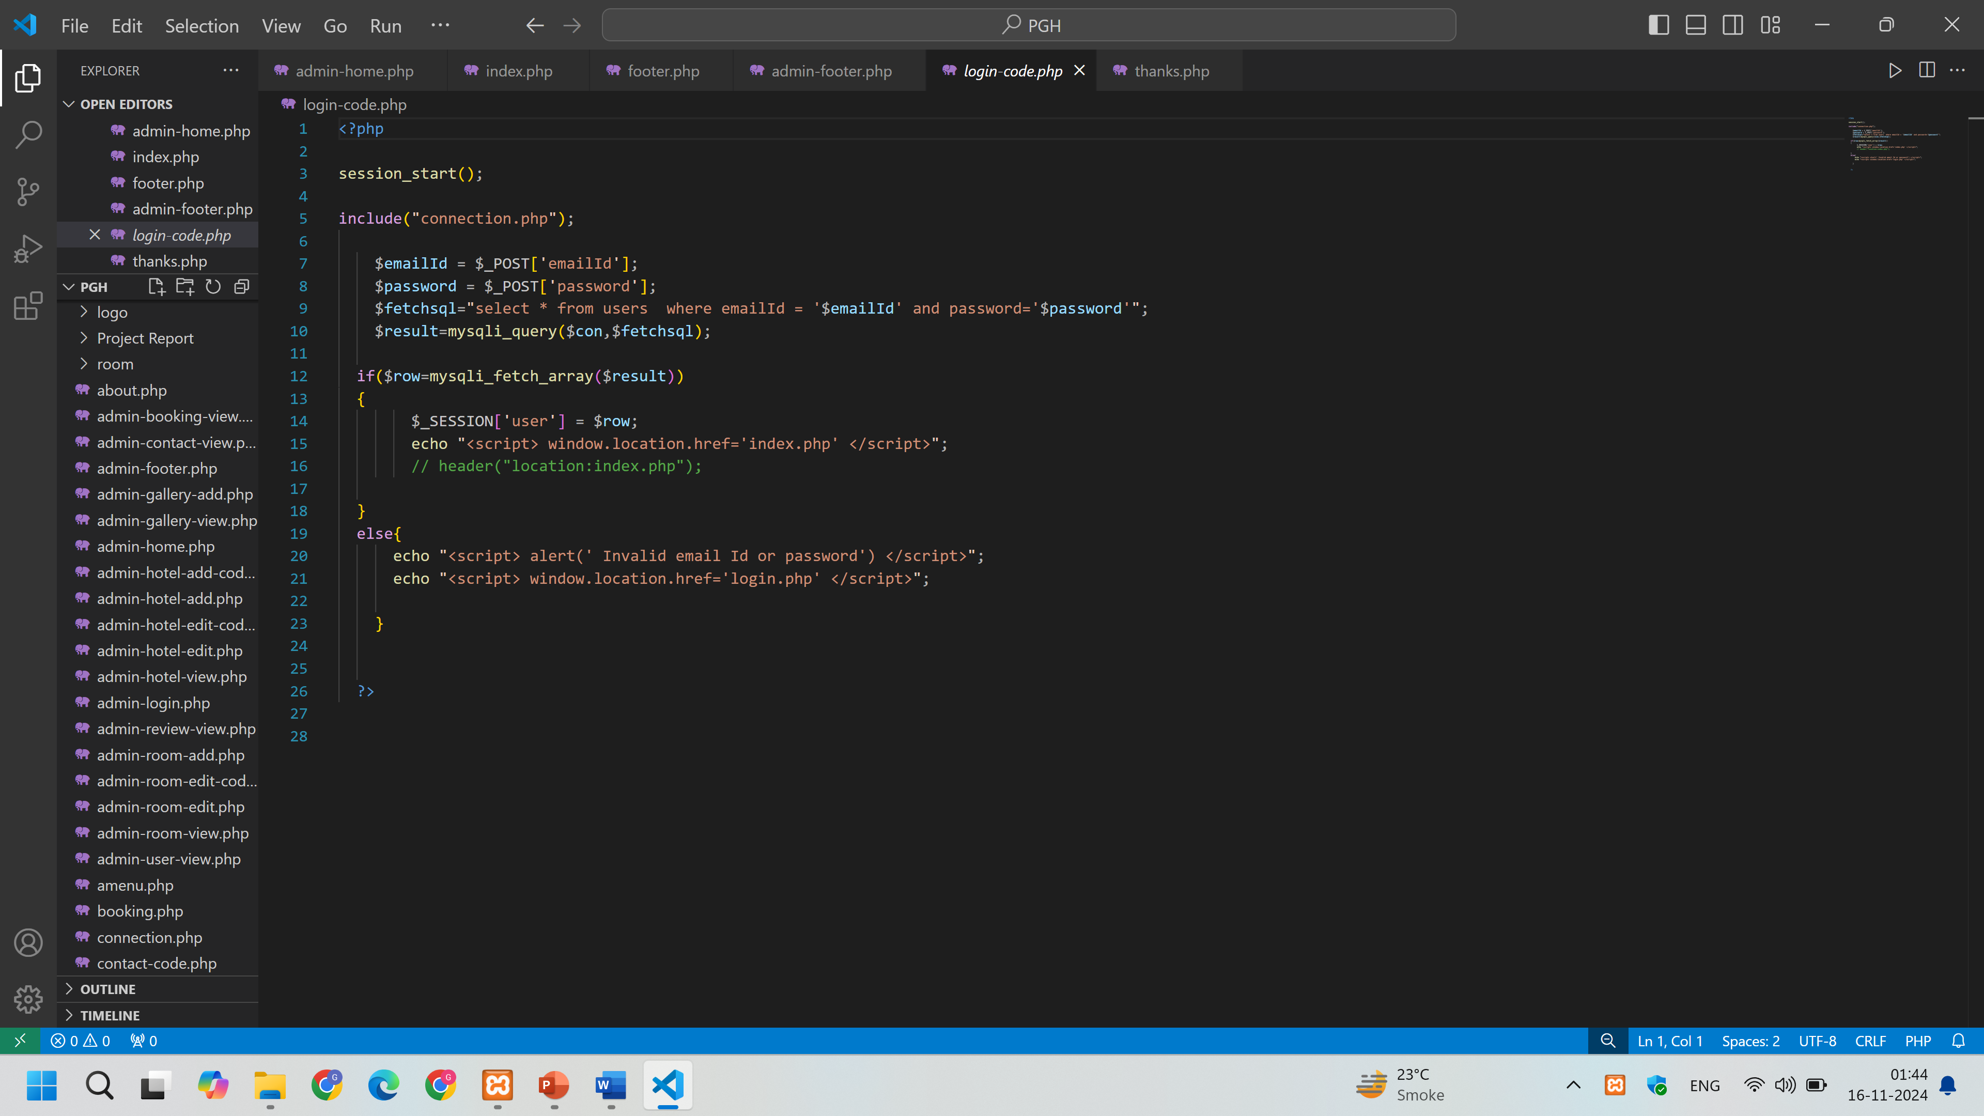

Slide 40
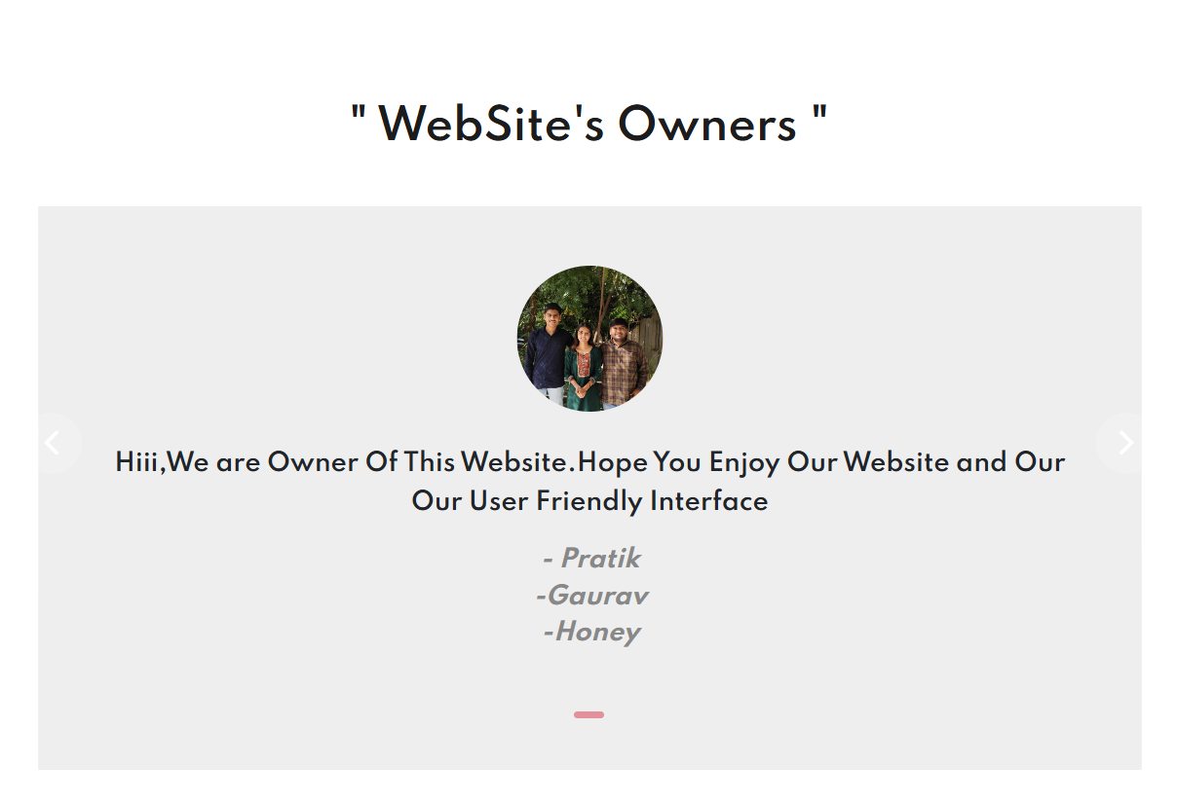

Slide 41
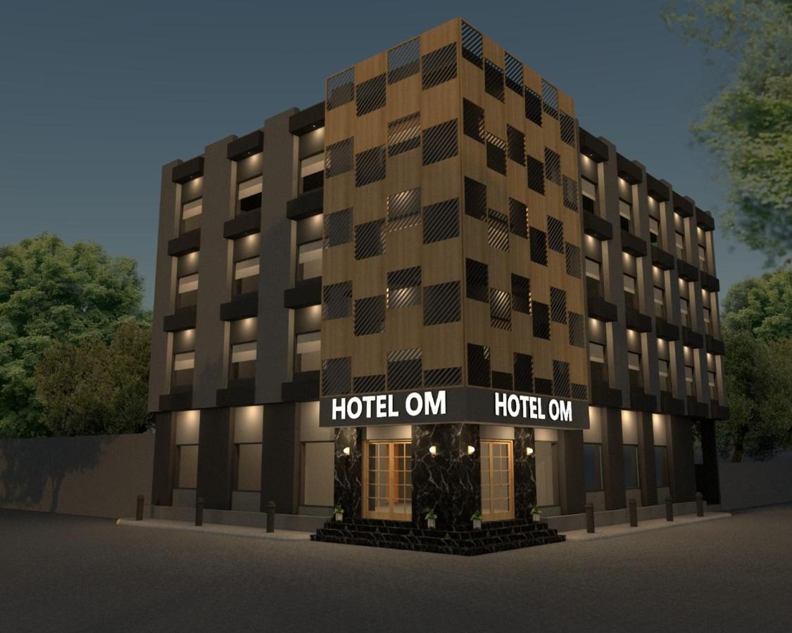
TESTING
Site testing is a basic component of site quality confirmation and addresses a definitive survey of determination, plan, and coding. Testing addresses a fascinating irregularity for the Site. The testing stage includes testing of the framework utilizing different test information. Planning of test information assumes a crucial part in framework testing. Subsequent to setting up the test information, the framework under review is tried utilizing those test information. In the event that testing is led effectively, it uncovers the mistakes in the Site. Also, testing exhibits that Site capabilities seem, by all accounts, to be working as per particular and execution necessities seem to have been met. Likewise information gathered as testing is led gives a decent sign of Site dependability and some sign of Site quality all in all.
The improvement of the Site frameworks includes a progression of creation exercises where valuable open doors for infusion of human questionability are gigantic. Mistakes might start to happen at very commencement of the cycle where the goals might be wrongly or defectively determined as well as in later plan and advancement stages. In light of human failure to perform and speak with flawlessness, Site improvement is trailed by a quality confirmation movement.

Slide 42
LIMITATIONS & FUTURE EXTENSIONS
1. LIMITATIONS:
Require more accuracy.
Provide less functionality.
Online payment facility are not available.
2. FUTURE EXTENSIONS:
In an advance technology we provide more and more satisfaction to users.
The capability of our service will be increased provided to see the user profile.
In the future we add OTP system to Register.
In future we gave a Notification, Message and E-mail facility.
Also added Premium Version For user to the advance facility.

Slide 43
CONCLUSION AND REFERENCES
8.1 CONCLUSION
It has been a great pleasure for us to work on this exciting and challenging project. This project proved good for us as it provided practical knowledge of not only programming in PHP application and no some extent Windows Application and MYSQL, but also about all handling procedure related with “job searching”.
It also provides knowledge about the latest technology used in developing web enabled application and client server technology that will be great demand in future. This will provide better opportunities and guidance in future in developing projects independently.
In my project PGH hotel booking is easy for users to book hotel rooms. In it, the user will get all information related to the hotels. PGH hotel booking is for user can book hotel room from here.

Slide 44
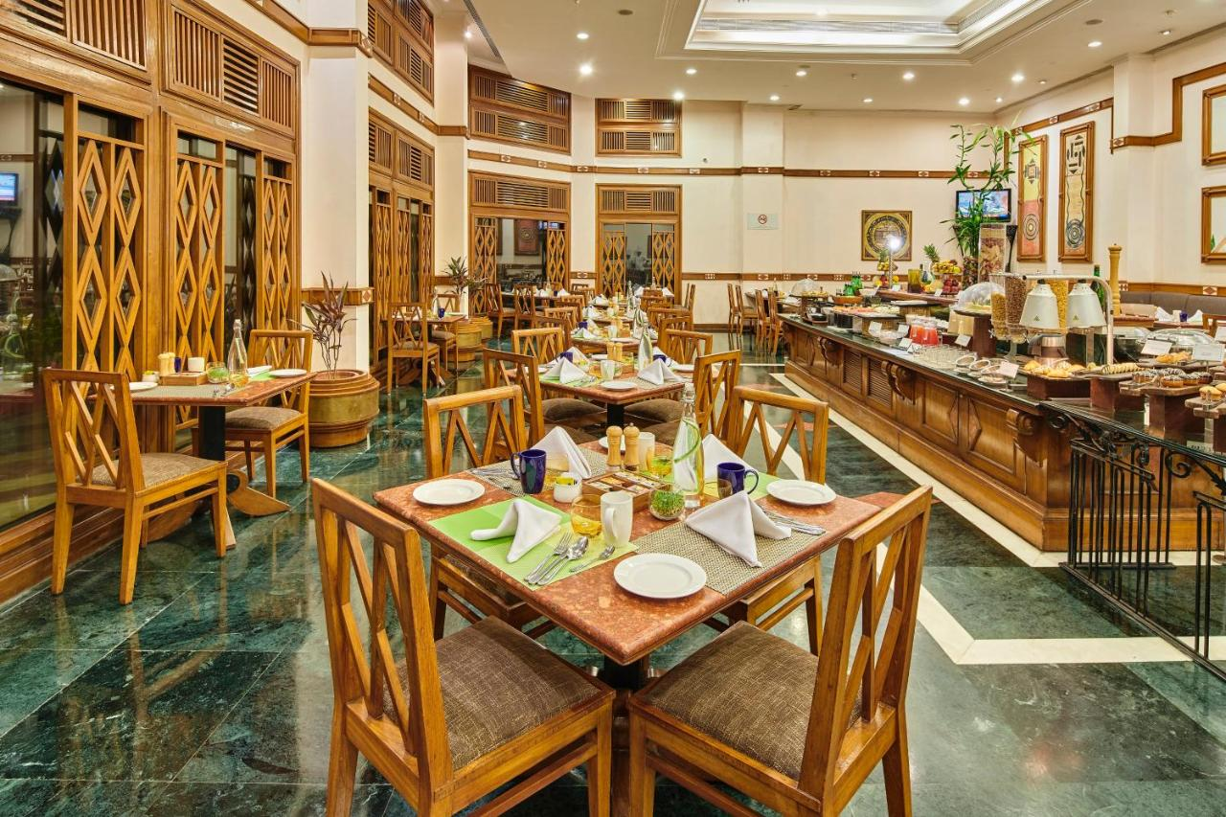
8.2 REFERENCES
Websites:
www.goibibo.com
www.trivago.in

Slide 45
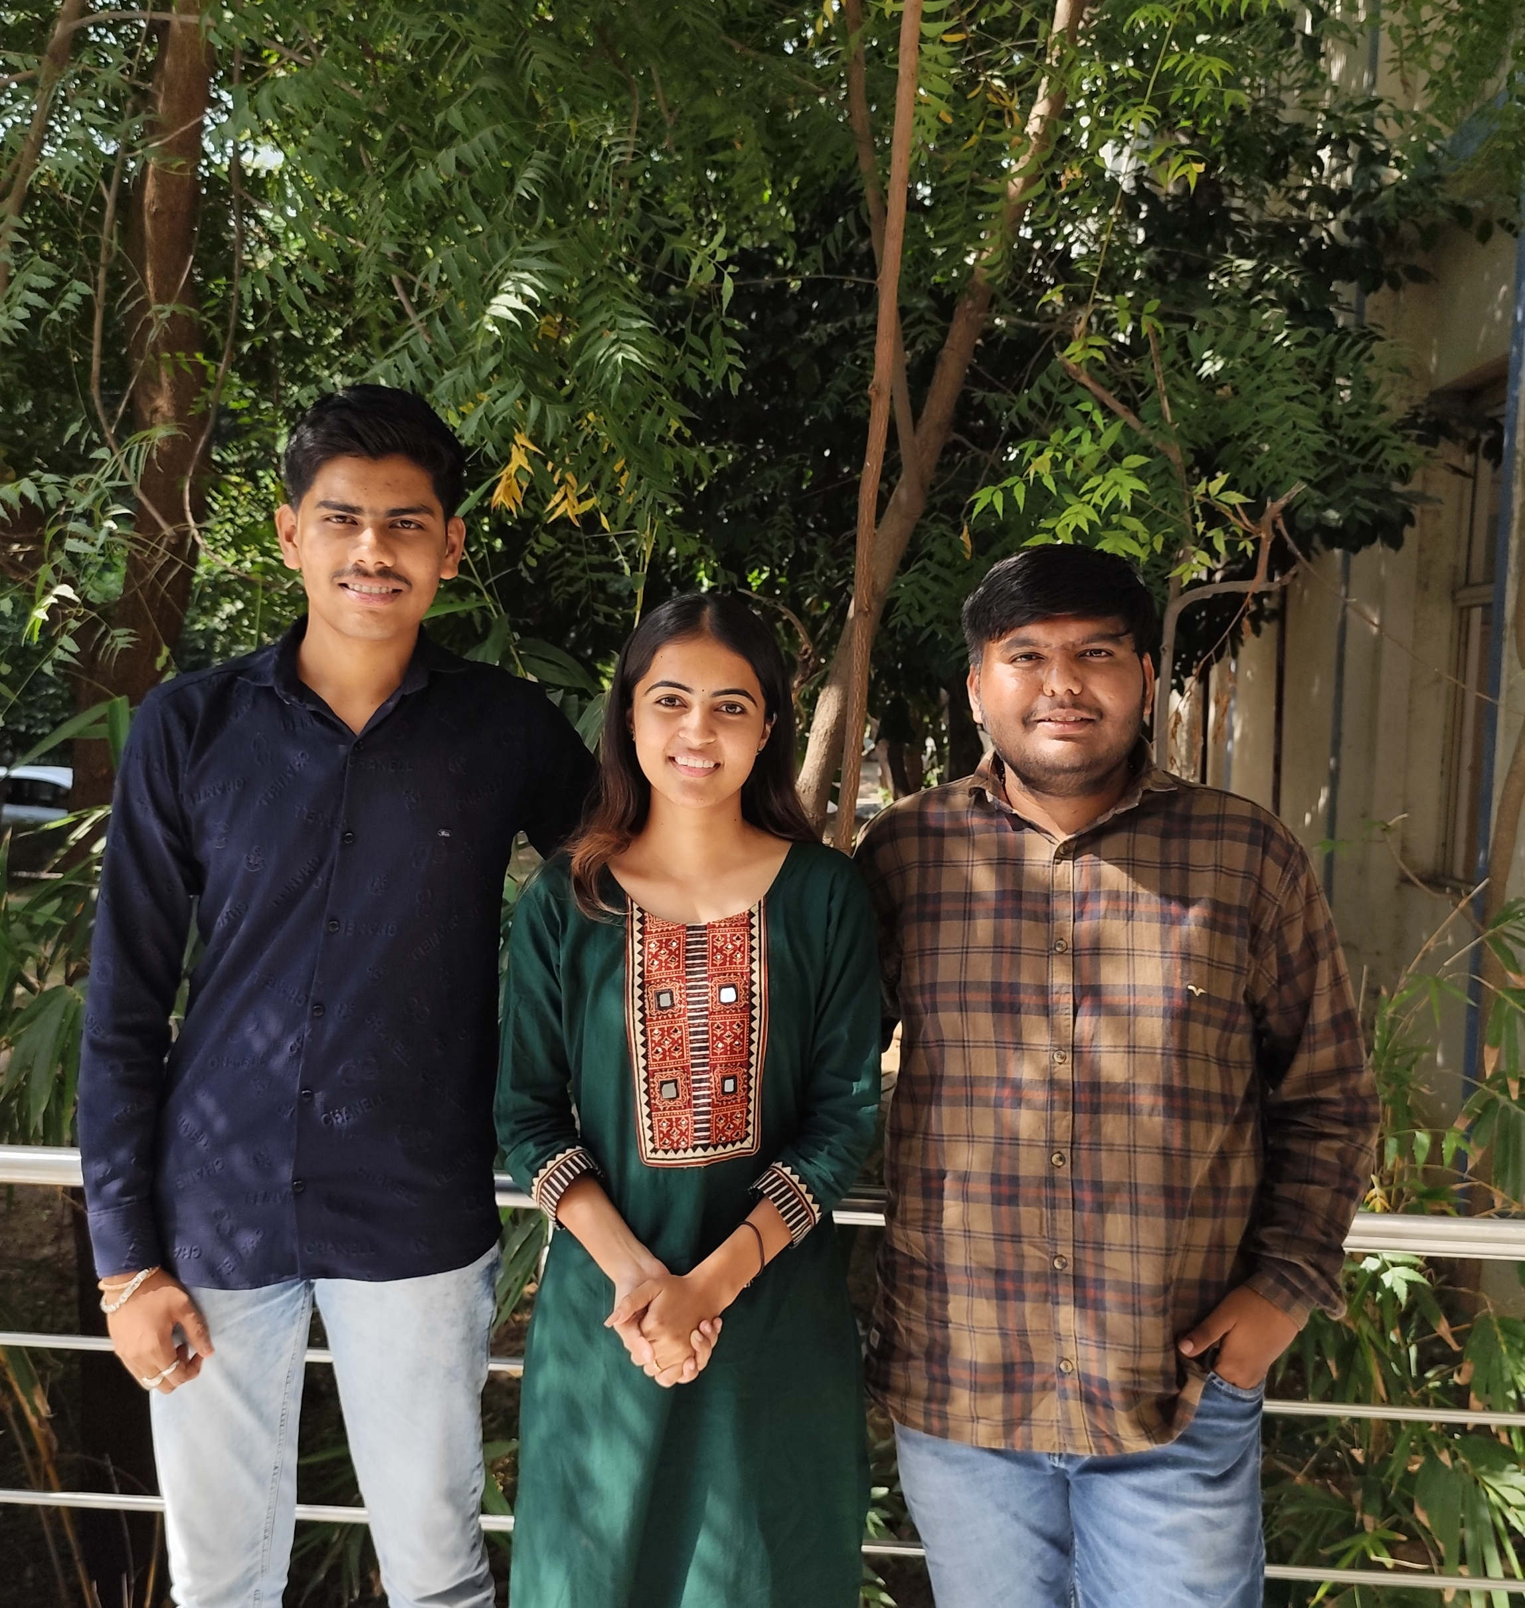
THANK YOU

